Slide 1
July 2019
July 25-26 three drones crossed abrupt front on leading edge ~4hr from each other

Slide 2
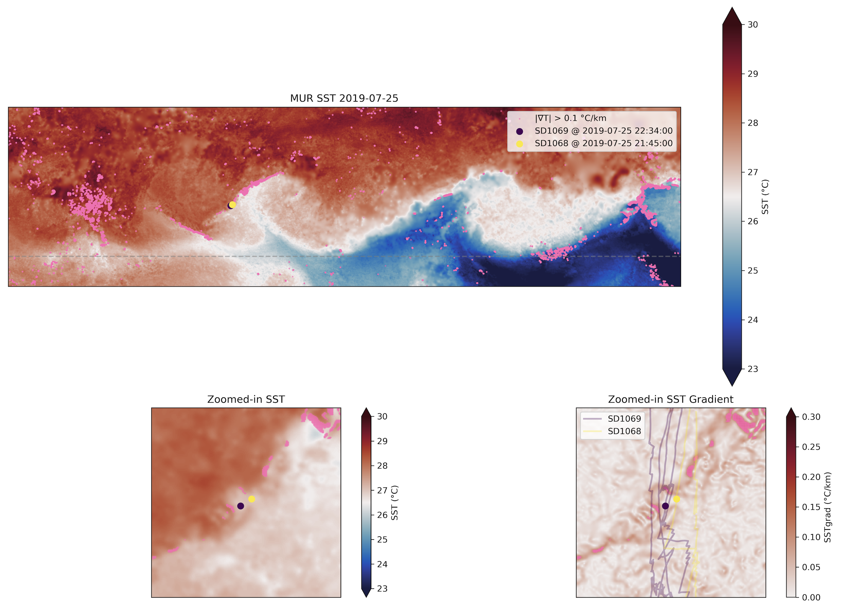
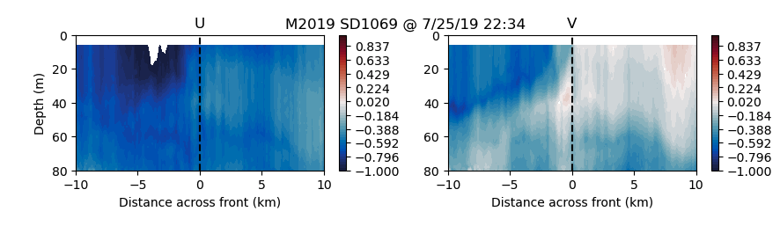
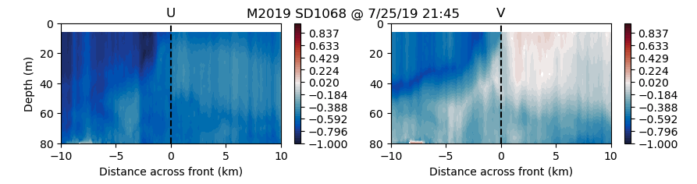
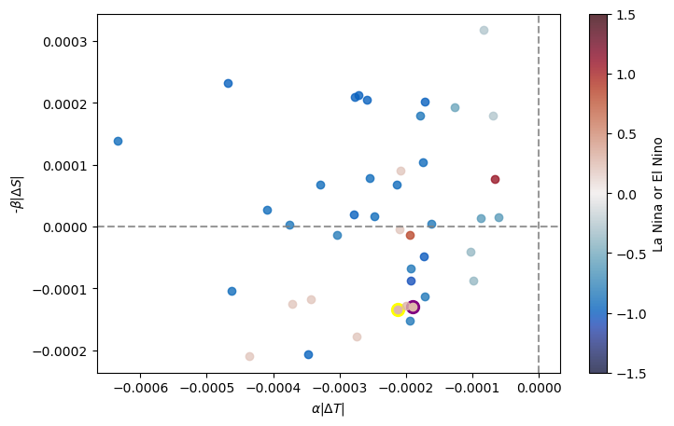
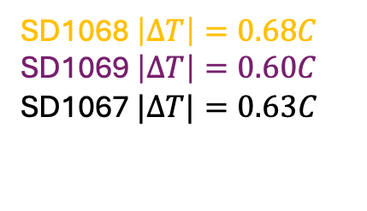
July 25th 2019
Two drones crossed ~1hr from each other
Daytime front
Temperature front
warm
cool
warm
cool
warm
cool
SD1068 $\left|∆T\right|=0.68C$
SD1069 $\left|∆T\right|=0.60C$
SD1067 $|∆T|=0.63C$

Slide 3
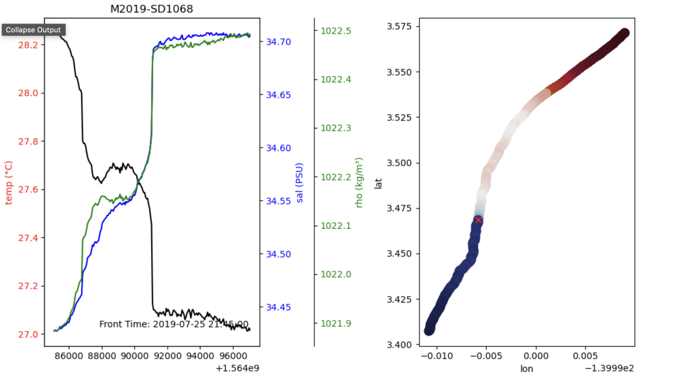
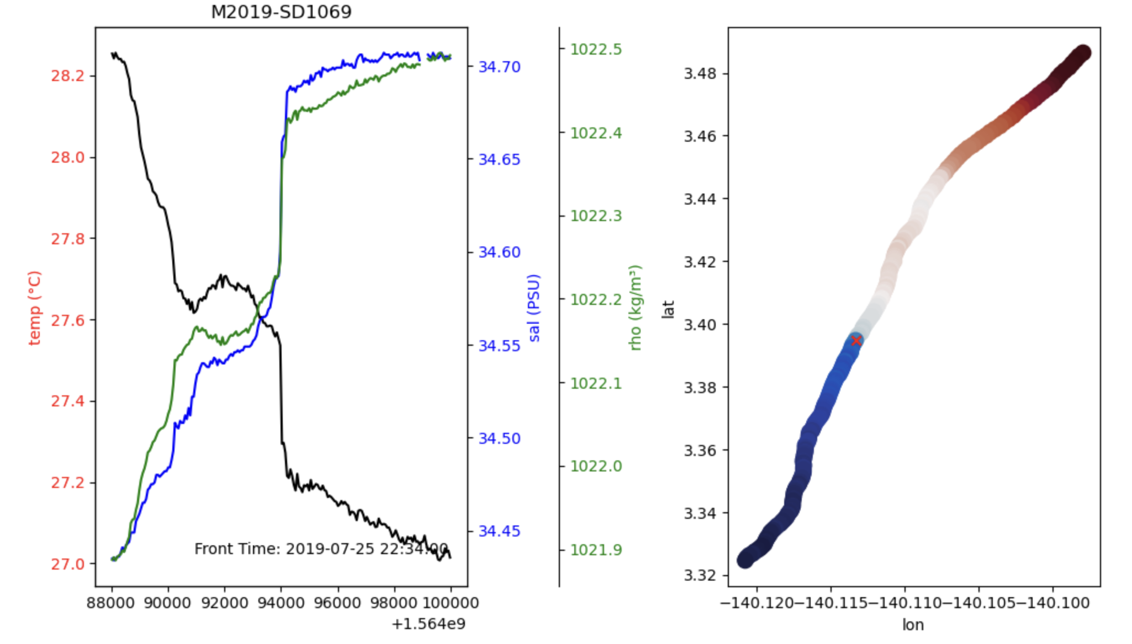

Slide 4
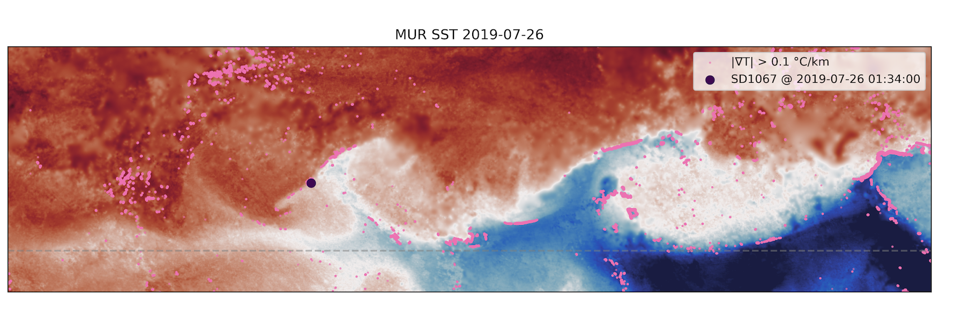
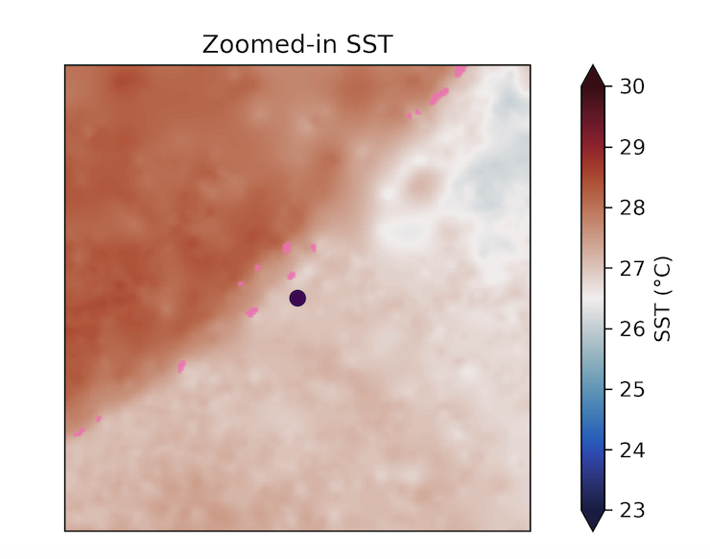
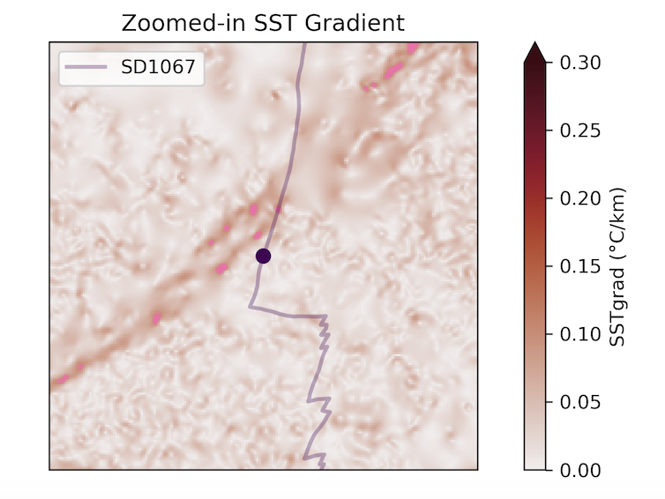
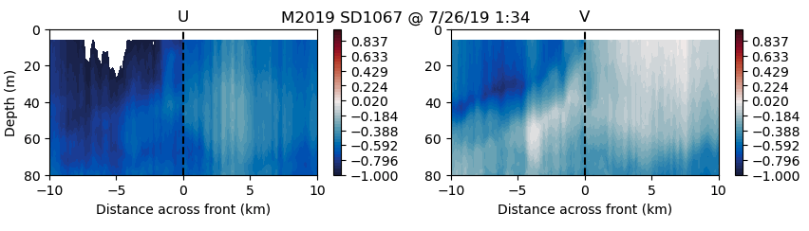
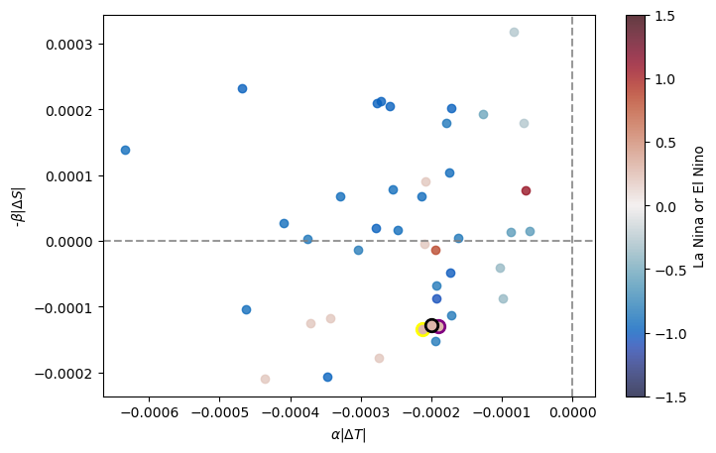
July 26th 2019
Third drone crossing front a few hours later
Satellite shows strengthening over day
warm
cool
warm
cool
warm
cool
SD1068 $\left|∆T\right|=0.68C$
SD1069 $\left|∆T\right|=0.60C$
SD1067 $|∆T|=0.63C$

Slide 5
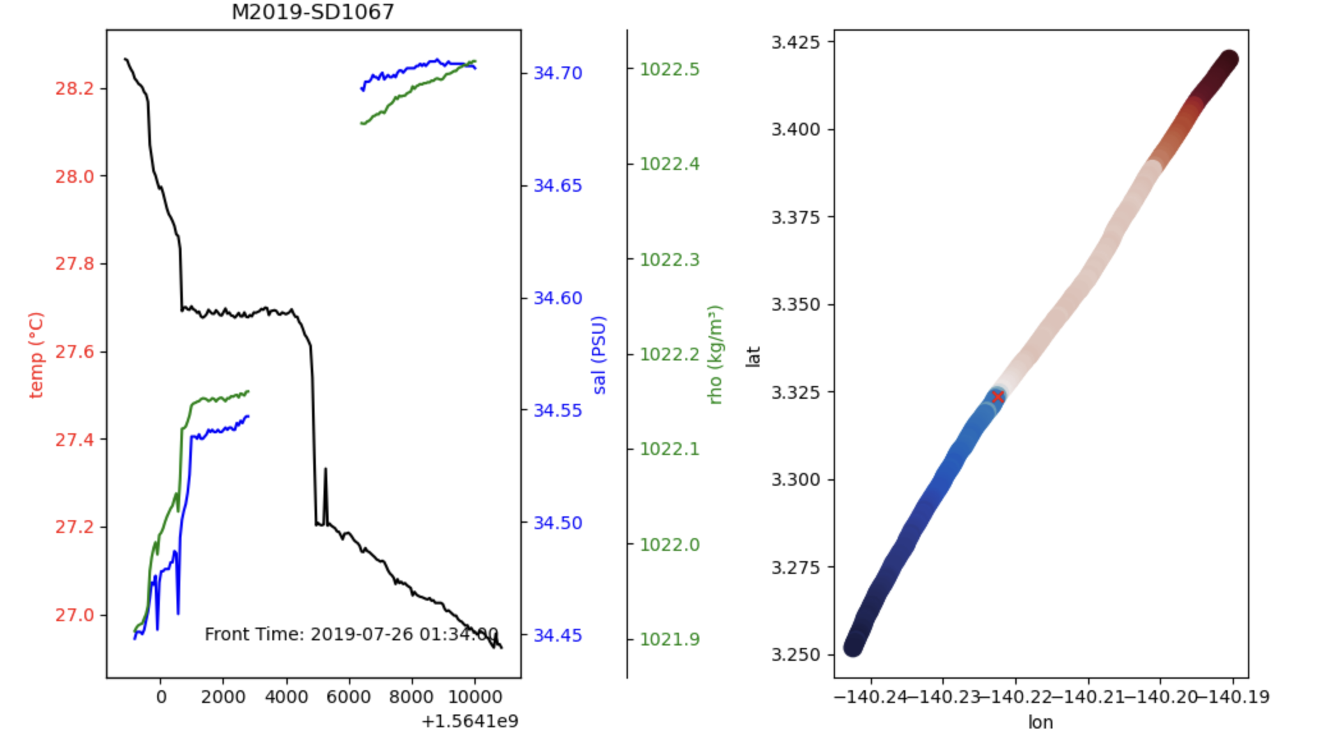

Slide 6
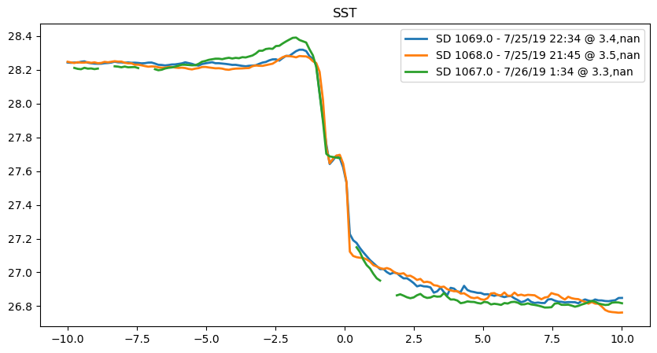
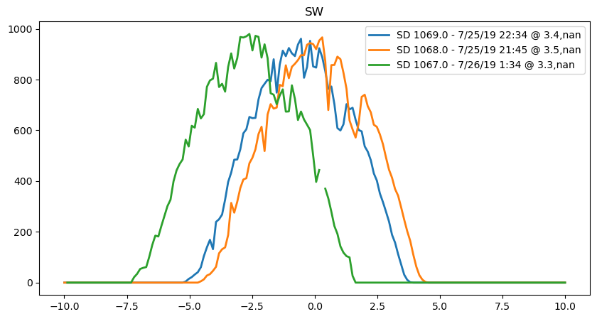
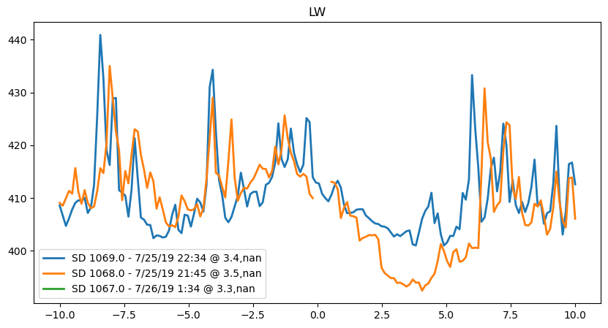
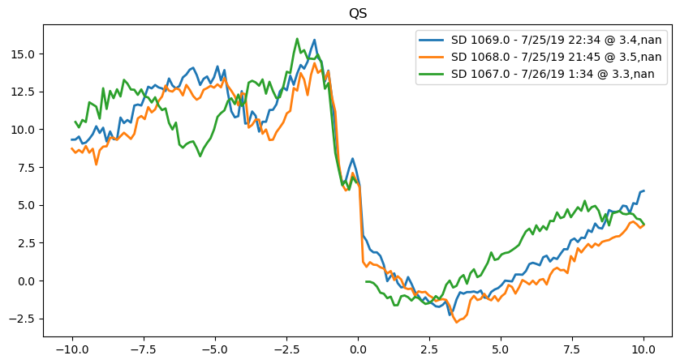
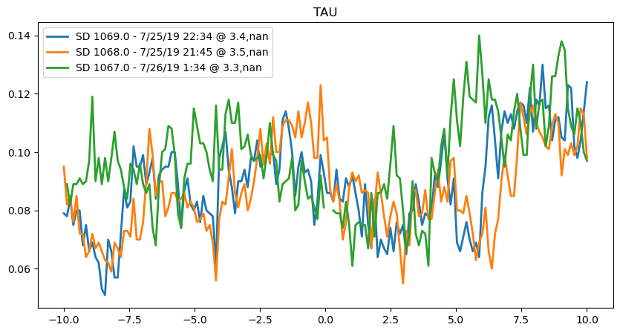
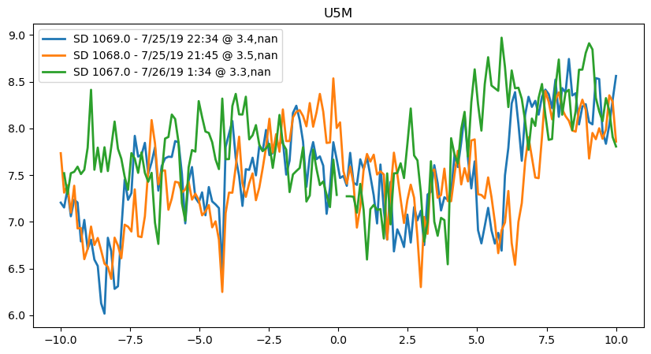
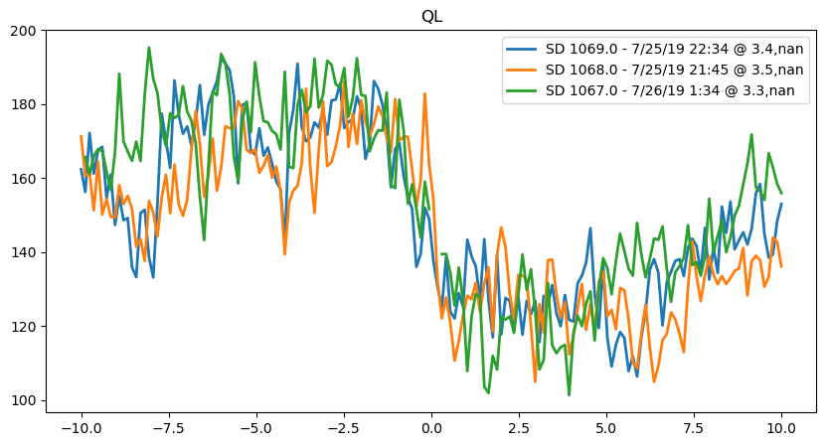
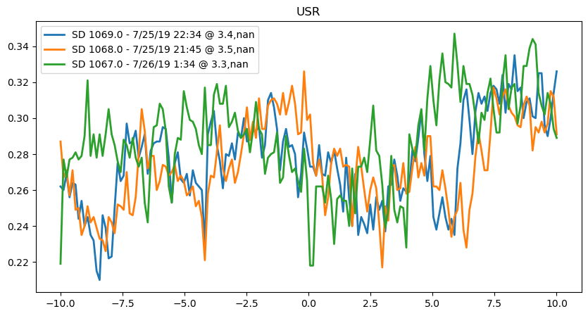

Slide 7
Sep 2019
July 25-26 three drones crossed abrupt front on leading edge ~4hr from each other

Slide 8
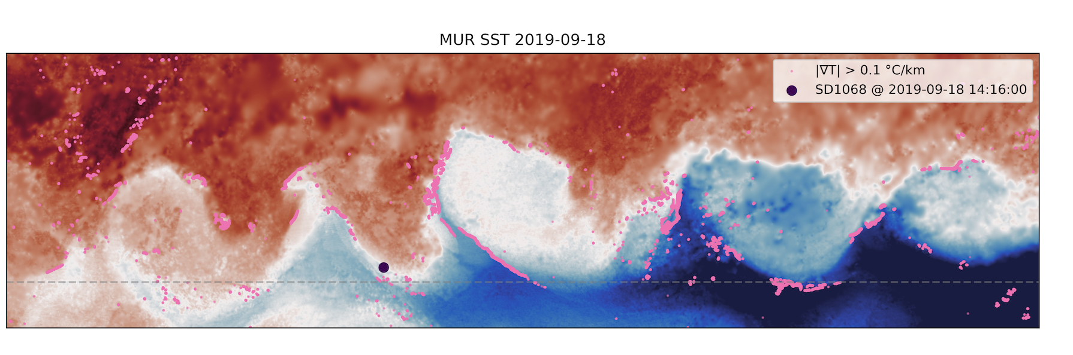
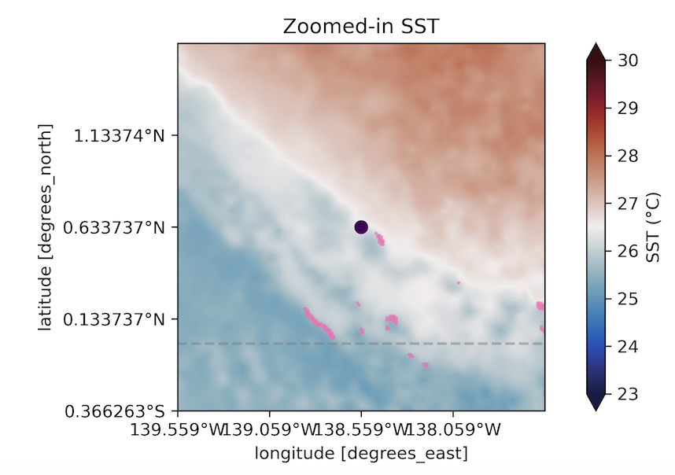
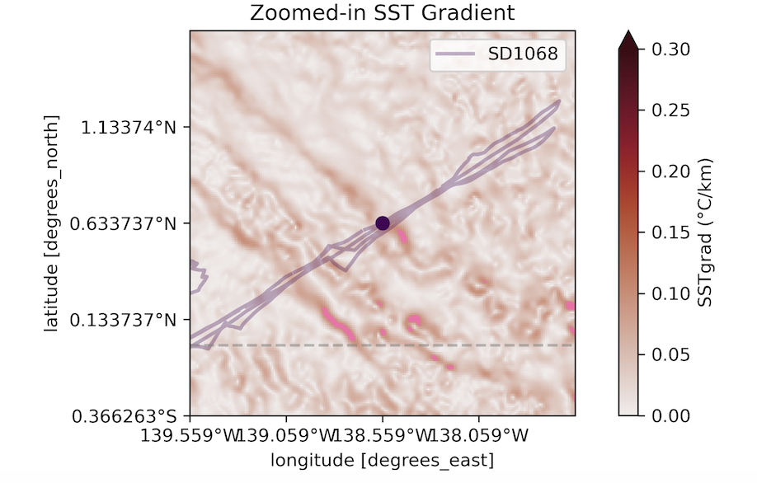
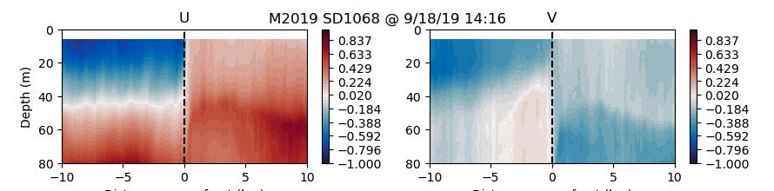
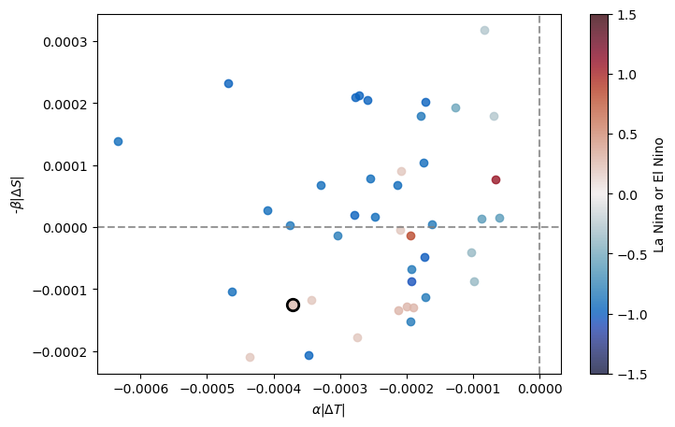
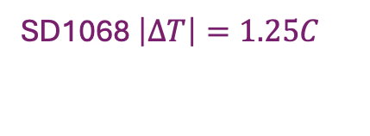
Sep 18th 2019
warm
cool
warm
cool
SD1068 $\left|∆T\right|=1.25C$

Slide 9
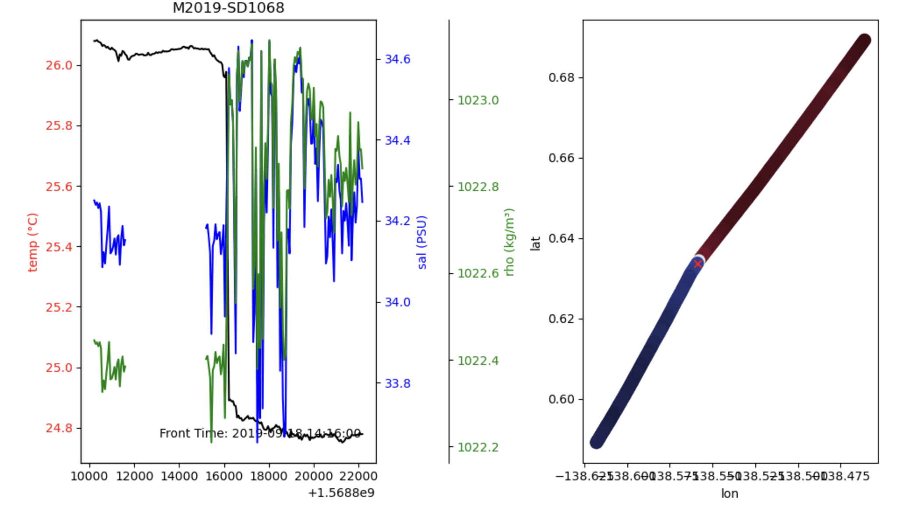

Slide 10
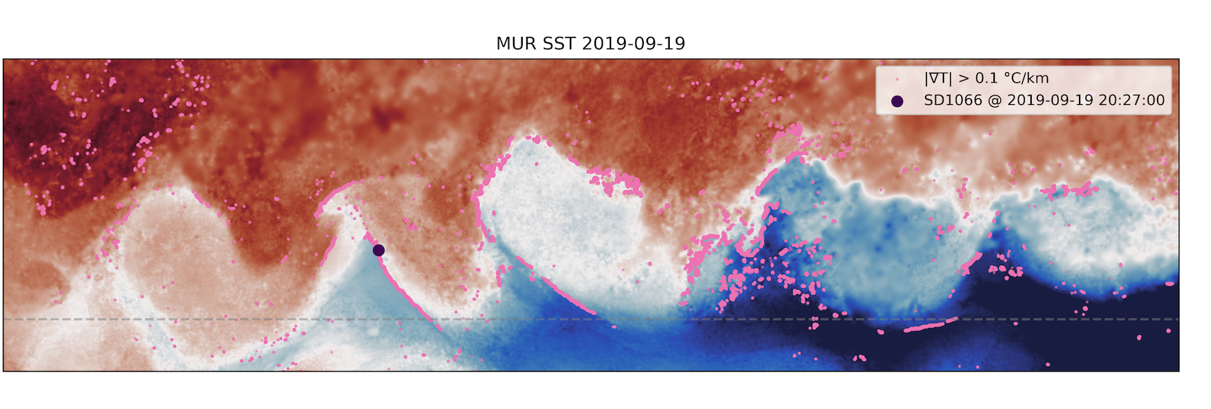
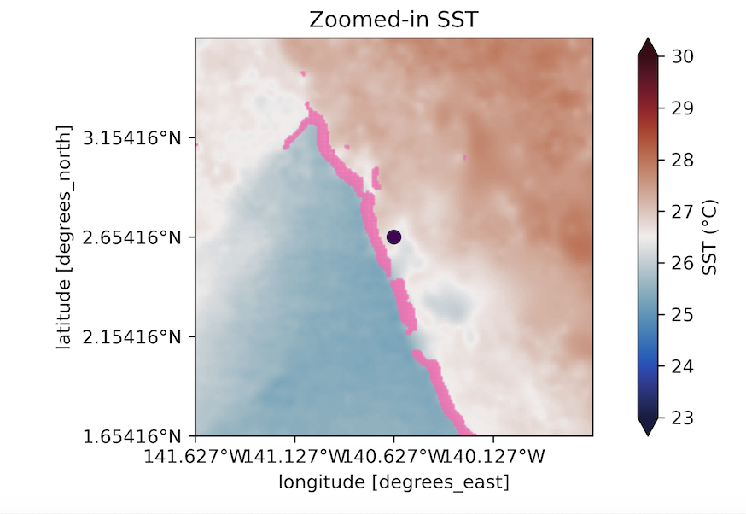
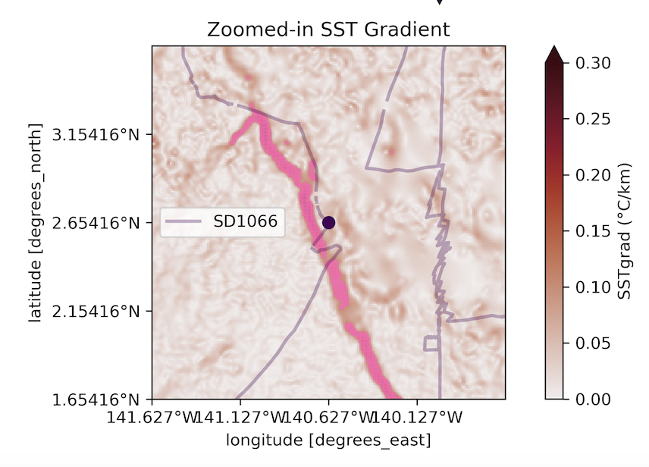
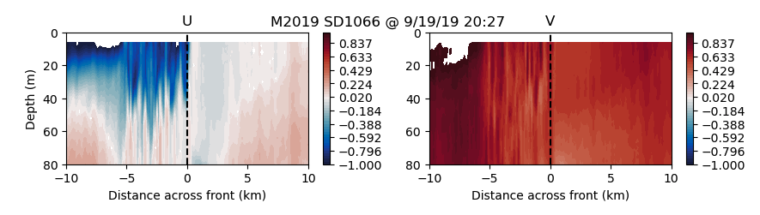
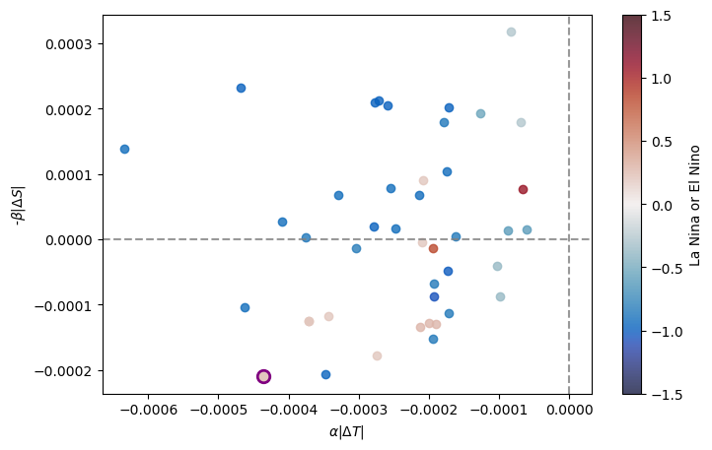

Sep 19th 2019
warm
cool
warm
cool
SD1066 $\left|∆T\right|=1.44C$

Slide 11
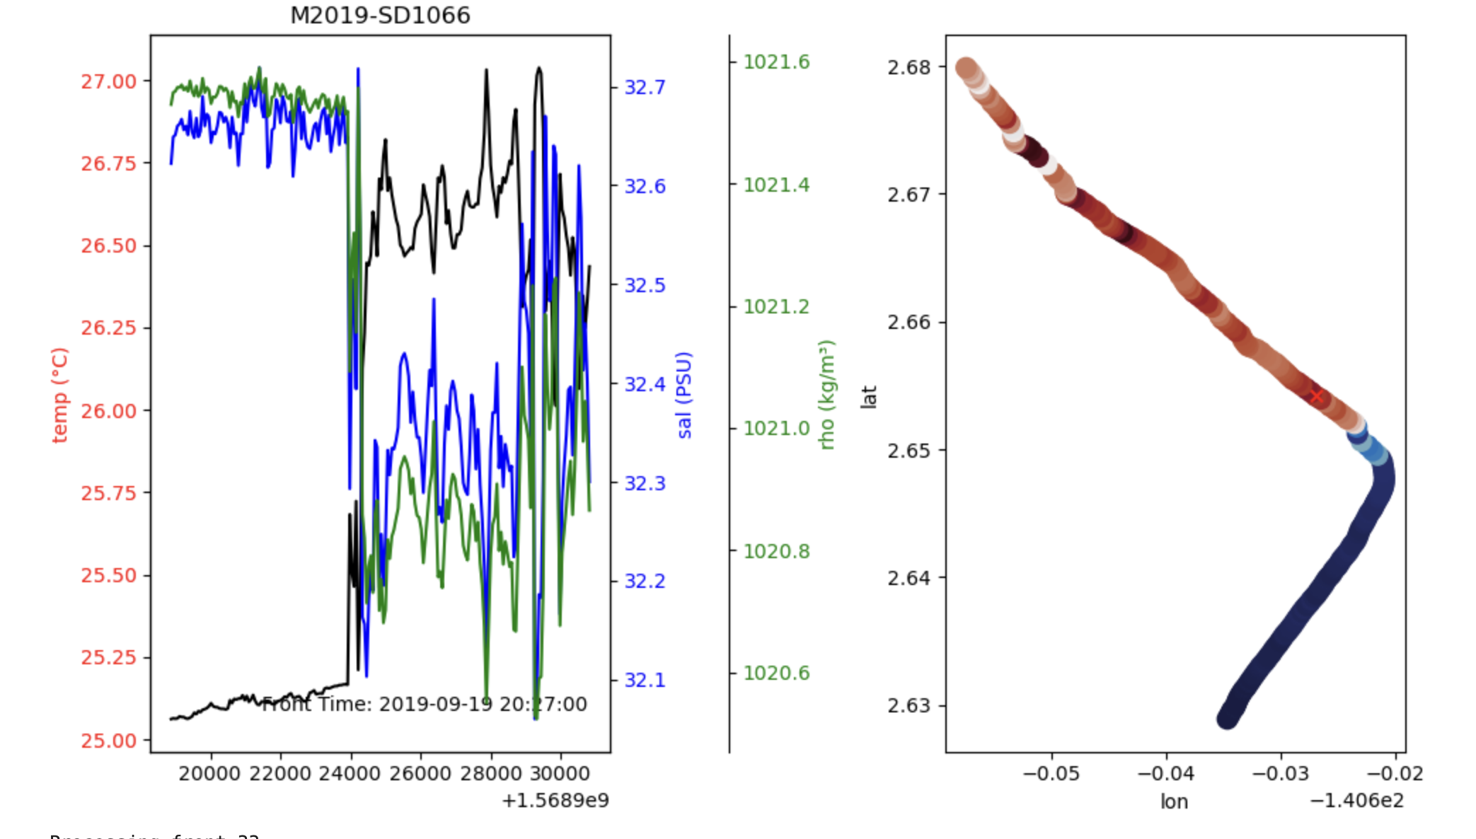

Slide 12
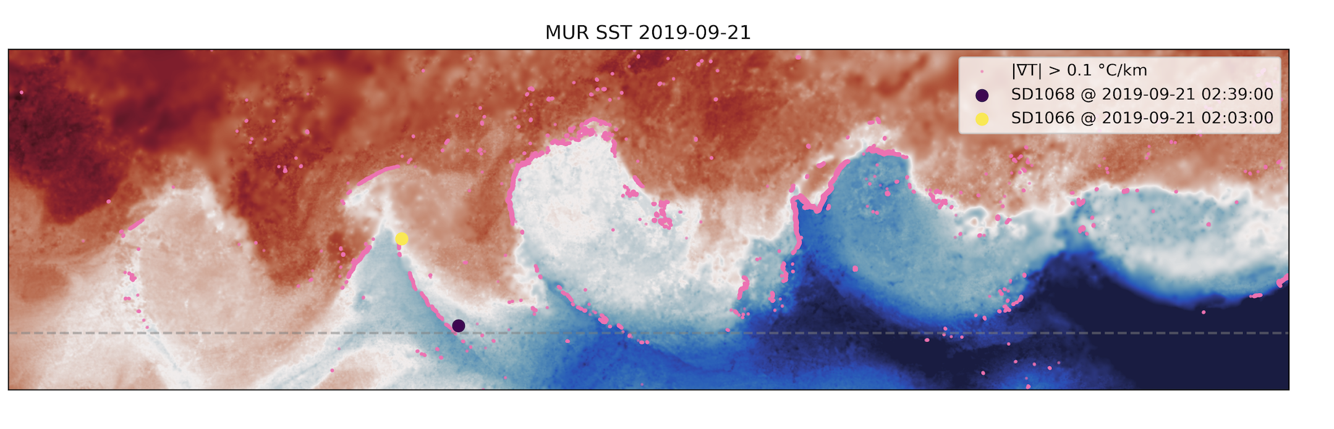
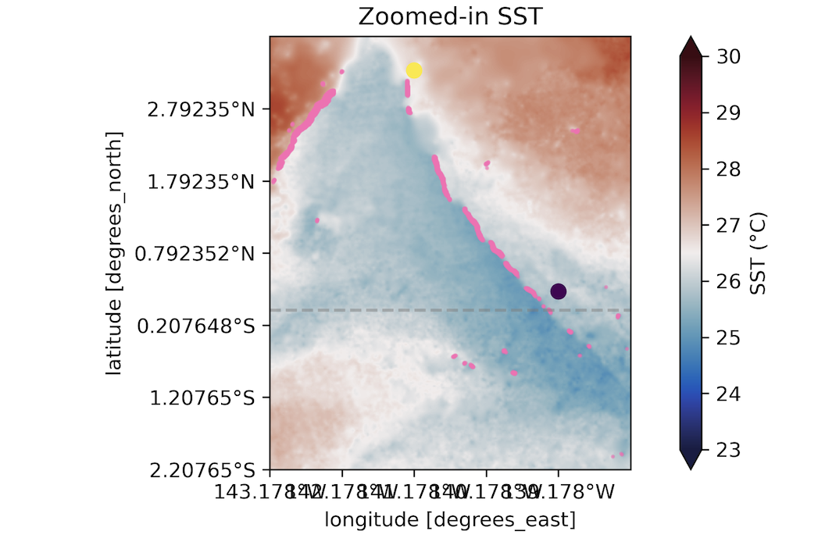
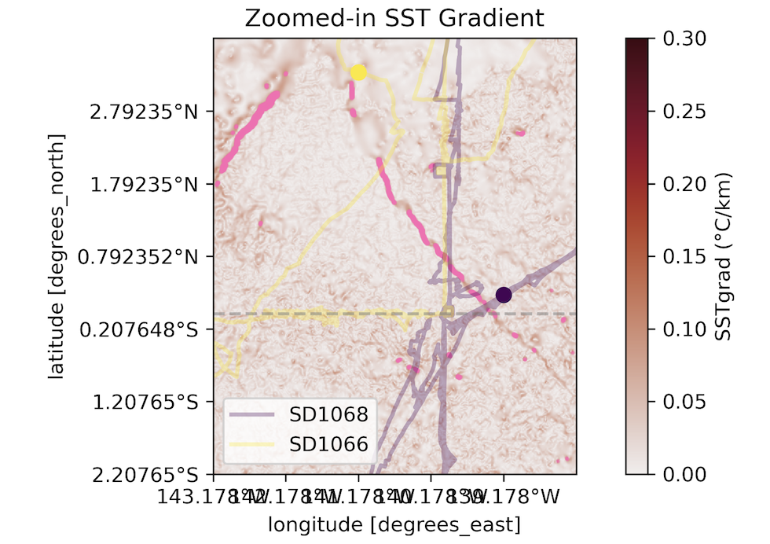
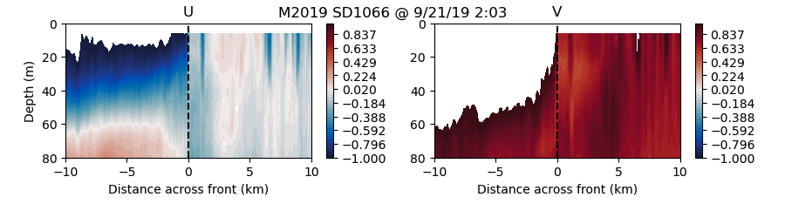
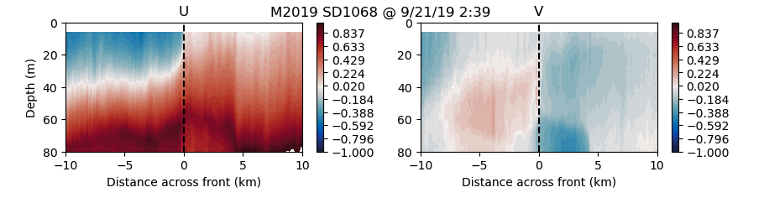
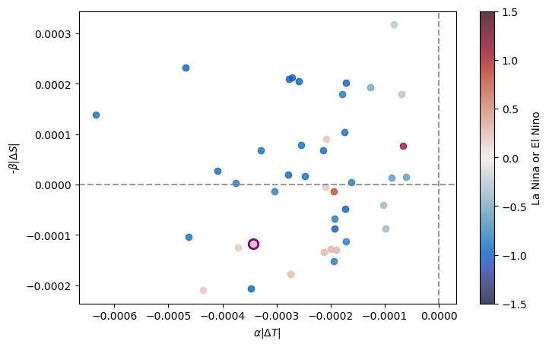
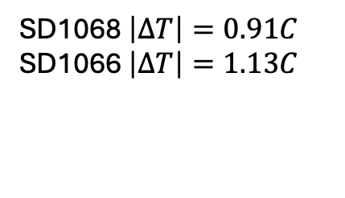
Sep 21th 2019
warm
cool
warm
cool
SD1068 $\left|∆T\right|=0.91C$
SD1066 $\left|∆T\right|=1.13C$

Slide 13
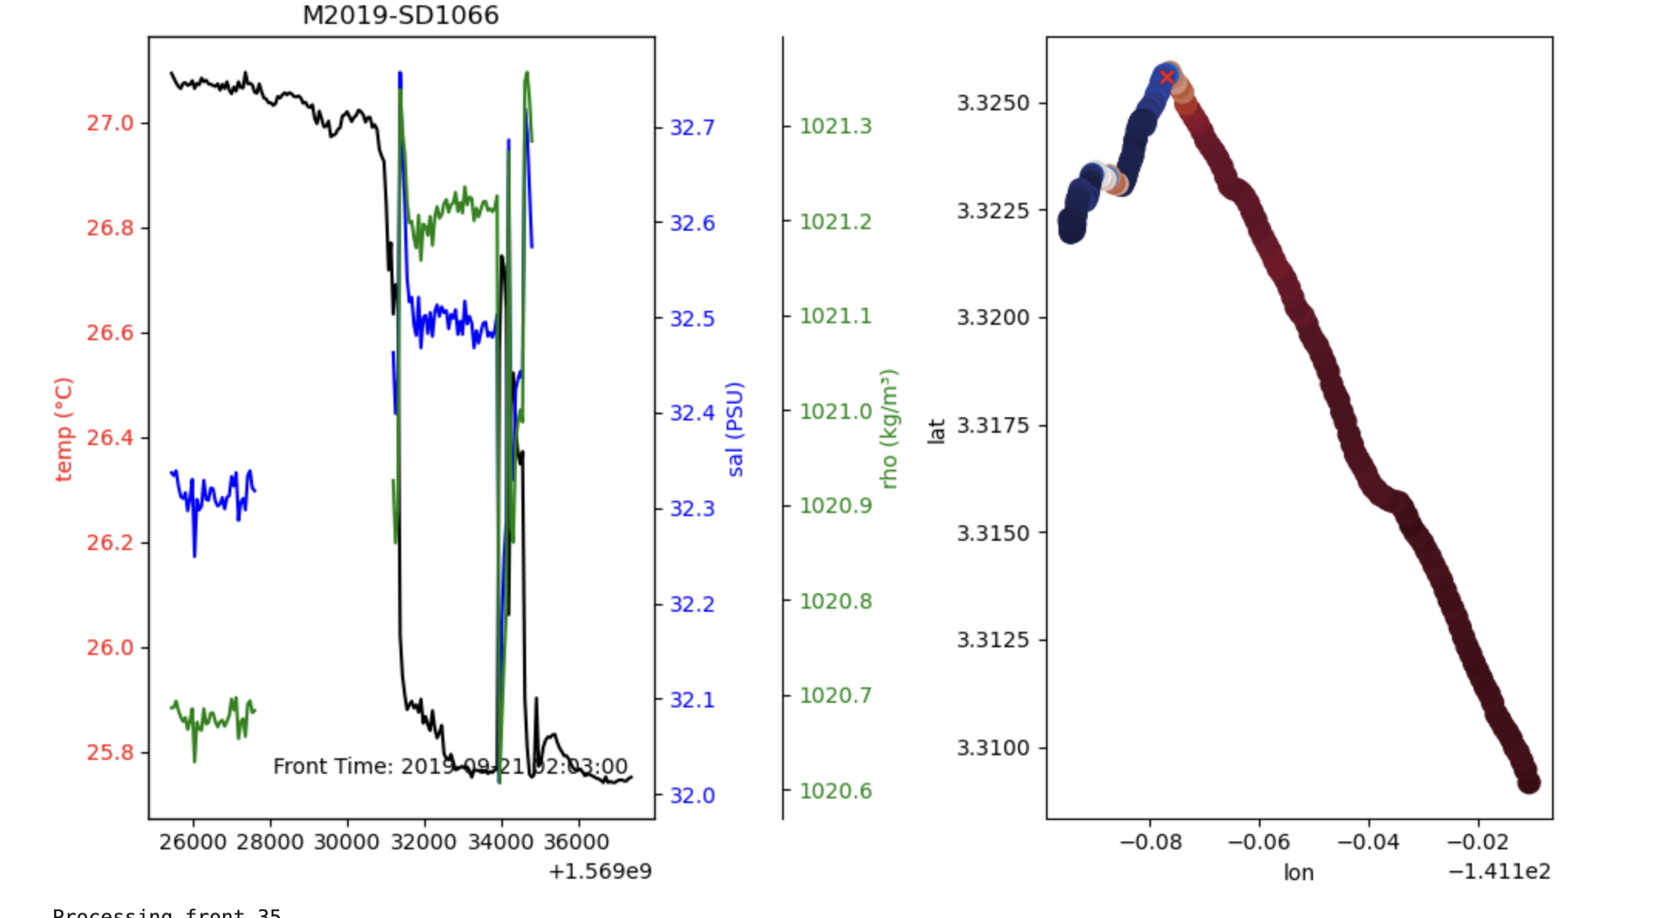
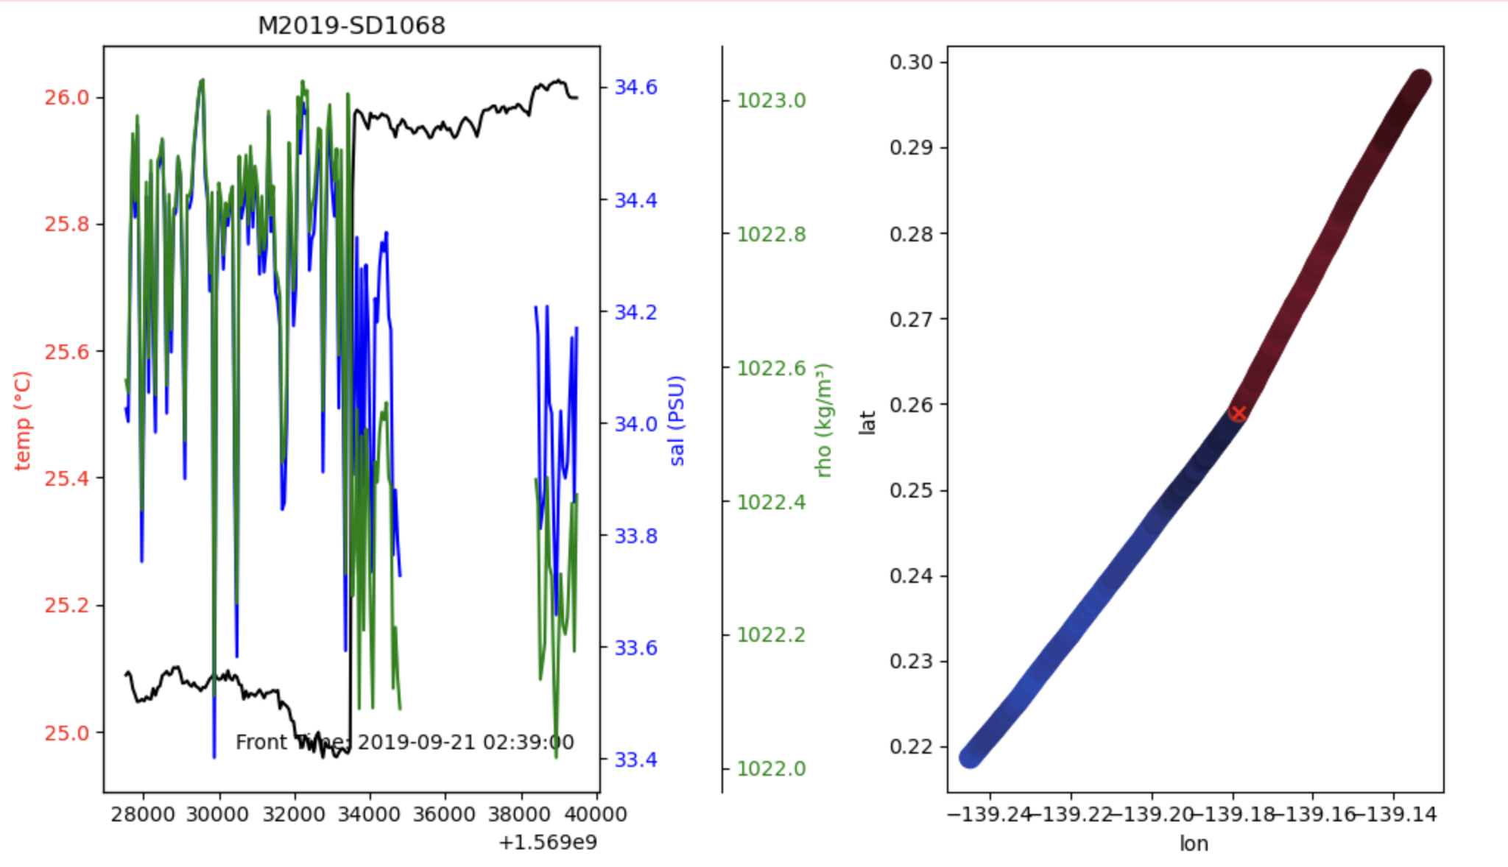

Slide 14
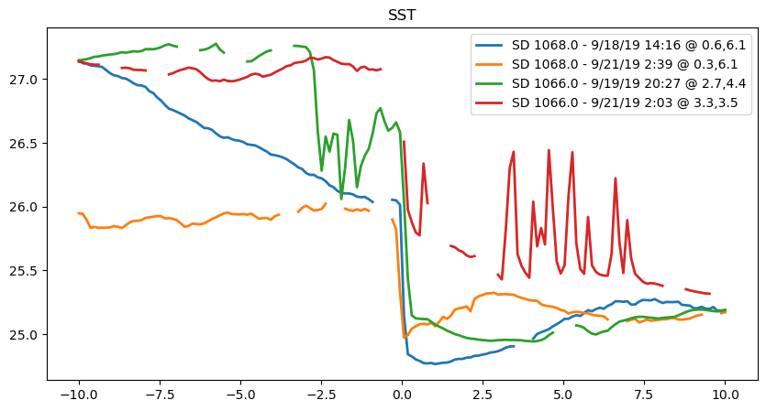
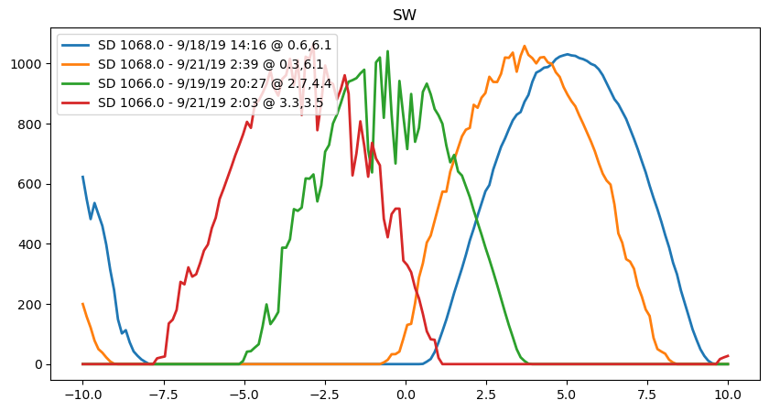
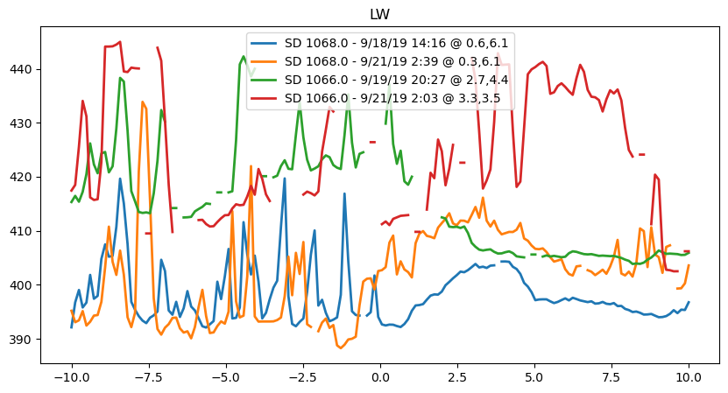
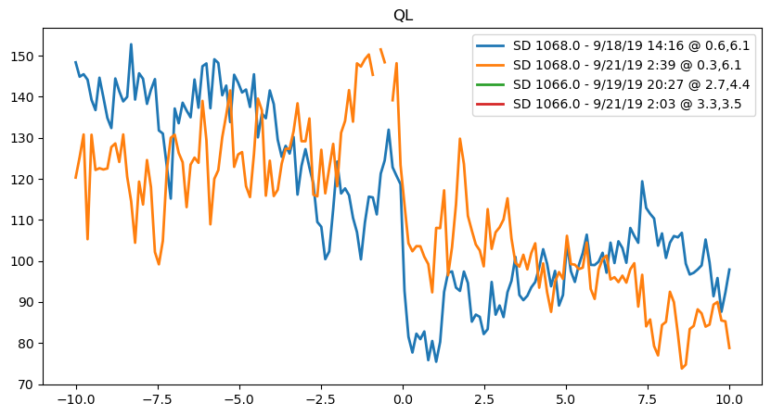
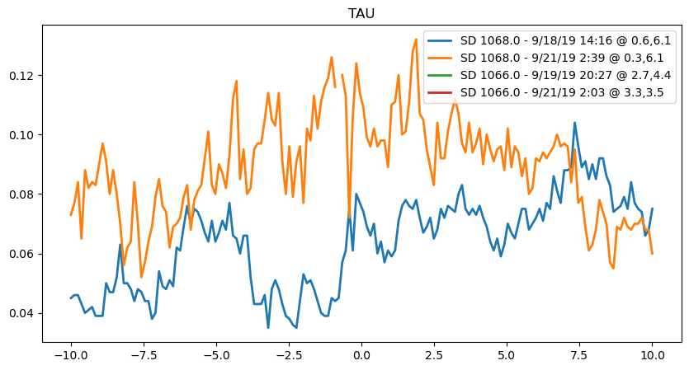
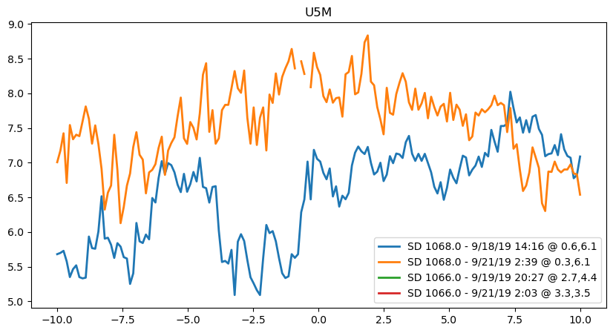
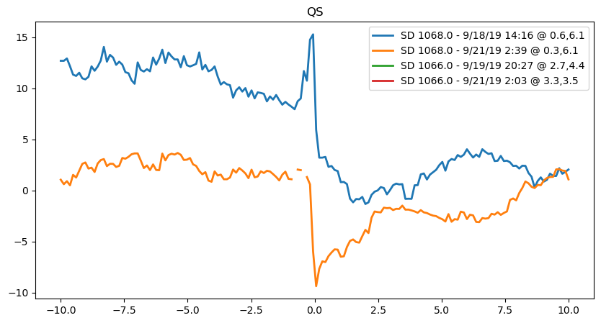


Slide 15
Compute horizontal density gradient:
Plot vertical sections of U, V, and density across the front.
Do you see signs of overturning or vertical motion in V?
Estimate cross-frontal ageostrophic velocity (like in Pérez et al. 2010 or Cronin and Kessler):
Compare with expected Ekman secondary circulation:
Is surface flow converging/diverging across the front?
Is there upwelling/downwelling on one side of the front?

Slide 16
"Do submesoscale fronts embedded within tropical instability waves support ageostrophic secondary circulations?"
"What role does frontal Ekman dynamics play in shaping vertical transport at submesoscale tropical ocean fronts?"
Abrupt fronts are accompanied by ageostrophic secondary circulation driven by frontal Ekman dynamics
Notes:
Look for vertical shear and signs of convergence/divergence across the front.
Check if surface currents deviate from geostrophy → that’s your ageostrophic piece.
Surface geostrophic currents vs observed
Ekman pumping velocities from winds

